Slide 1

Training the Trainers: How do we educate staff in modern technologies?
Dr Vinny Davies
University of Glasgow

Slide 2
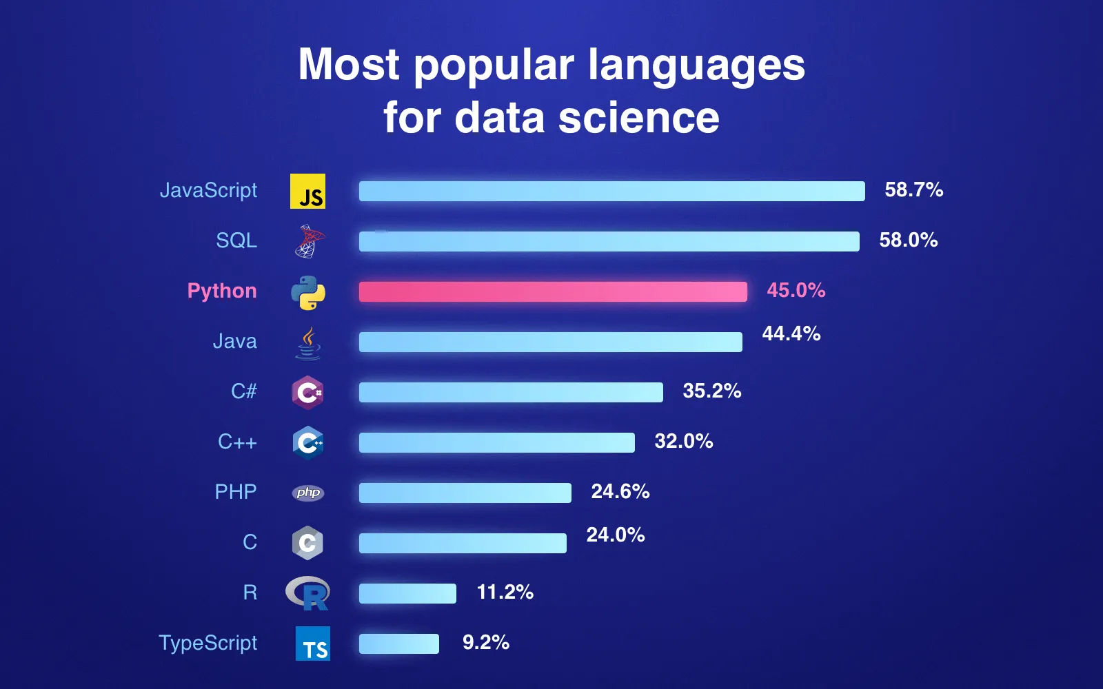
Why do we need new technologies?
Should statistics adapt to new technologies?
Should we educate students around new technologies?
What about less trusted technologies, e.g., ChatGPT?
It depends if they are used in practice
Industry?
Academia?
Government?

Slide 3


Past technologies
We have adapted in the past
What happened to Minitab?
Glasgow switched from Minitab to R around 2010
Most universities, presumably, now teach R as the core programming language
When I did my undergraduate (Lancaster) RStudio was just being introduced
What abut tidyverse?
What about Machine Learning?

Slide 4
Current & Future technologies
What are technologies you adding / do you want to add?
At the University of Glasgow, we are now adding:
Python
Version Control (as Craig has spoken about)
AI (e.g., Deep Learning)
Generative AI (e.g., ChatGPT)
What do we do about our staff not being comfortable teaching these courses?

Slide 5
Why upskill Staff?
Teaching
Teaching will change, so staff need to know about new technologies
Can’t just rely on a small number of staff
For students to learn effectively the technologies must appear in more courses
Student projects will also change, staff will struggle to help
Research
Research is changing like teaching
Upskilling our staff helps with research
Train better future staff (PGRs) and leaders

Slide 6
Skills Courses
What are we doing to upskill staff? One approach is skills courses
Staff don’t have time to take long courses, e.g. existing modules
They will engage is shorter training sessions / seminars
They will learn if their Ph.D. students begin using it
A contagious approach – you will learn it if others around you use it

Slide 7


A contagious approach
Staff educates PGR, or PGR educates Staff.
OR

Slide 8
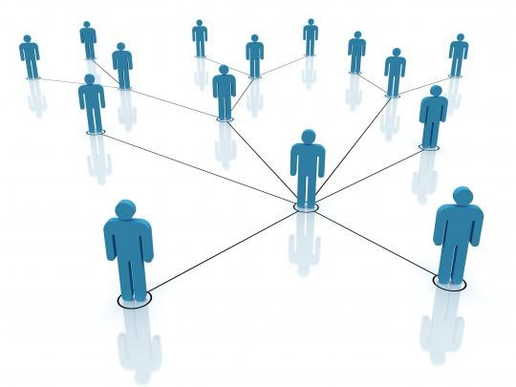

A contagious approach
Staff educates PGR, or PGR educates Staff. A network where everyone learns
OR

Slide 9

Multi Code Integration
For students to properly learn new technologies, they must be integrated into multiple courses

Slide 10
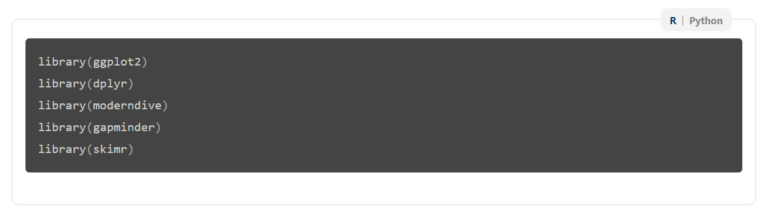
R-Python Integration
Jack, E., Alexander, C., McArthur, D., & Mair, C. (2023). Reflections on designing and delivering an online distance learning programme in the mathematical sciences. MSOR Connections, 21(2), 25-33.
Our accessible notes now allow switching between languages or descriptions
We first used this in our Version Control course for GitHub Desktop vs command-line
We can also use it for R vs Python

Slide 11
R-Python Integration
Jack, E., Alexander, C., McArthur, D., & Mair, C. (2023). Reflections on designing and delivering an online distance learning programme in the mathematical sciences. MSOR Connections, 21(2), 25-33.
Our accessible notes now allow switching between languages or descriptions
We first used this in our Version Control course for GitHub Desktop vs command-line
We can also use it for R vs Python

Slide 12
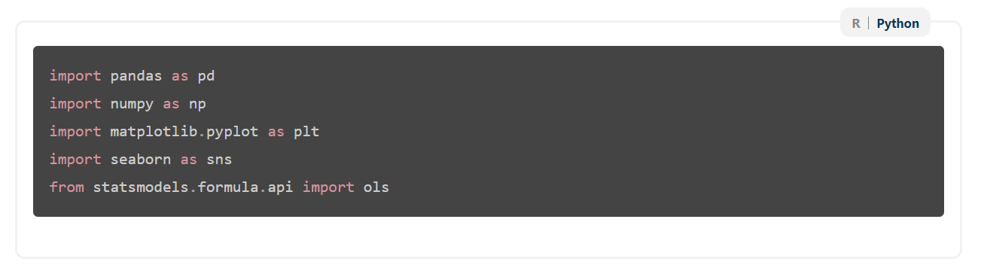
R-Python Integration
Jack, E., Alexander, C., McArthur, D., & Mair, C. (2023). Reflections on designing and delivering an online distance learning programme in the mathematical sciences. MSOR Connections, 21(2), 25-33.
Our accessible notes now allow switching between languages or descriptions
We first used this in our Version Control course for GitHub Desktop vs command-line
We can also use it for R vs Python

Slide 13
Benefits and Problems of Multi Code Integration
Benefits – Students see the programming languages throughout the programme
Problem – not many of our staff know Python
What are the impacts of multi code integration?
Does it force staff to learn basic Python?
Do we need to teach them?
Not in my opinion, but we need to provide them support
Drop-in sessions? PGR support?

Slide 14
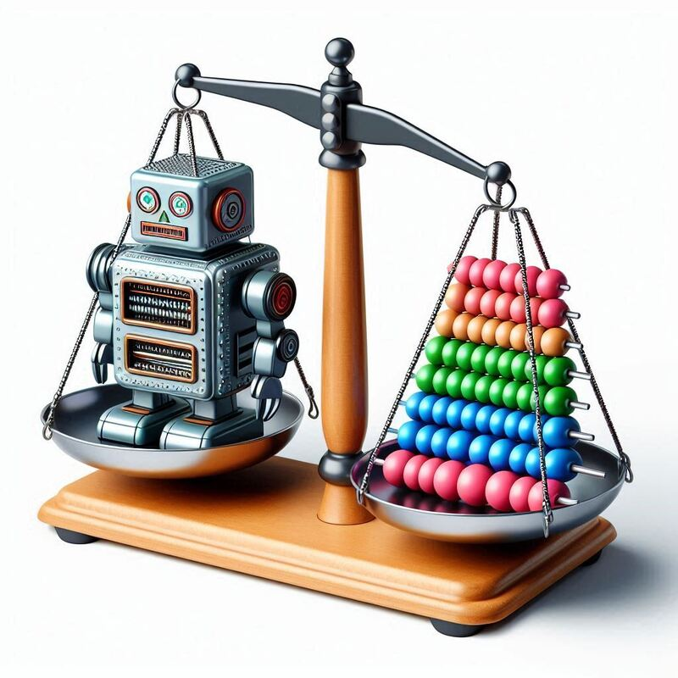
Teaching AI?
Teaching AI gives similar challenges
While their Ph.D. student might have started using it, not all staff are confident in teaching it
How do we integrate with current statistics and machine learning courses?
How do we teach enough staff about AI to not be reliant on a small number of staff?
Teaching staff AI seems implausible, so we are relying on them to learn via research and Ph.D. students

Slide 15
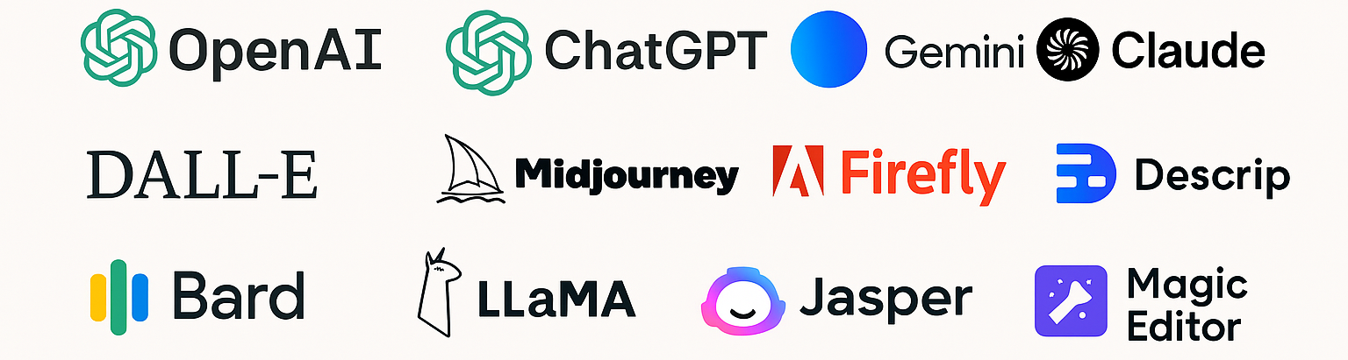
Teaching GenAI
What do we mean by teaching GenAI?
In this context, we mean teaching people how to use tools such as ChatGPT “properly”
What is “properly”?
How do we do this in the context of statistics?

Slide 16
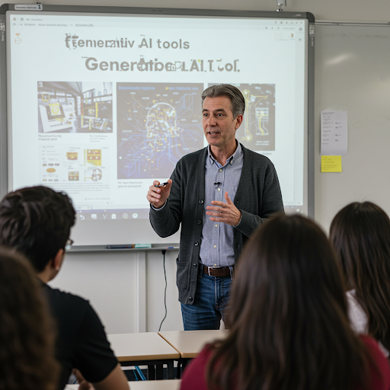
Why should we teach GenAI?
Policy at many institutes allows the use of GenAI
Our students and staff are using it whether we want them to or not
Students will use it in jobs once they graduate. How can they use it safely and effectively if they don’t understand it?
Can you see the 2+ major issues in this image?

Slide 17
Why should we teach GenAI?
Policy at many institutes allows the use of GenAI
Our students and staff are using it whether we want them to or not
Students will use it in jobs once they graduate. How can they use it safely and effectively if they don’t understand it?
Can you see the 2+ major issues in this image?

Slide 18
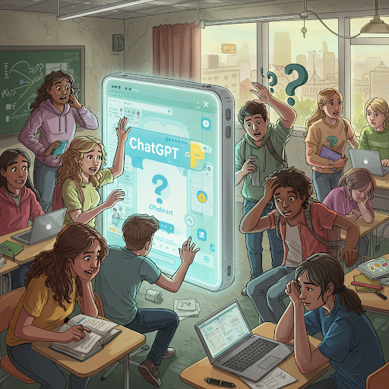
Students and GenAI
Currently our students are using it badly
We tried to encourage its more open use this year through the traffic light system
Students don’t understand how to learn from it, nor probably do staff or industry
Students tend to just throw entire questions into their favourite tool and don’t check what comes back out

Slide 19

Staff and GenAI
Its not just students… staff are using it badly as well…
They are using it where they shouldn’t be, and not where they maybe should be
Many just don’t understand what it is? Or how to use it effectively
Could it be used in a research context? UKRI allows it… I know Profs who already use it to write grants…

Slide 20
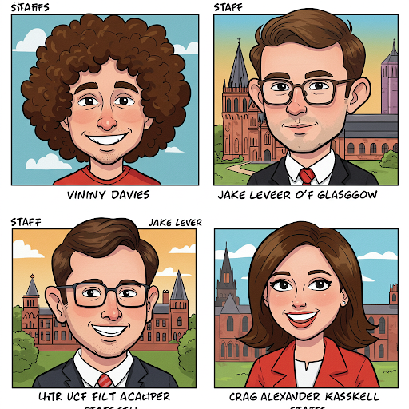
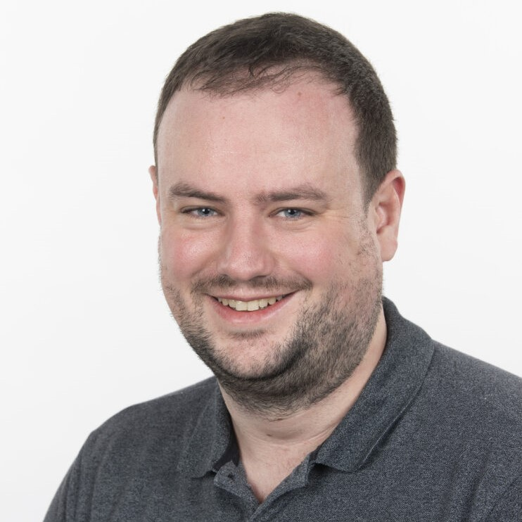

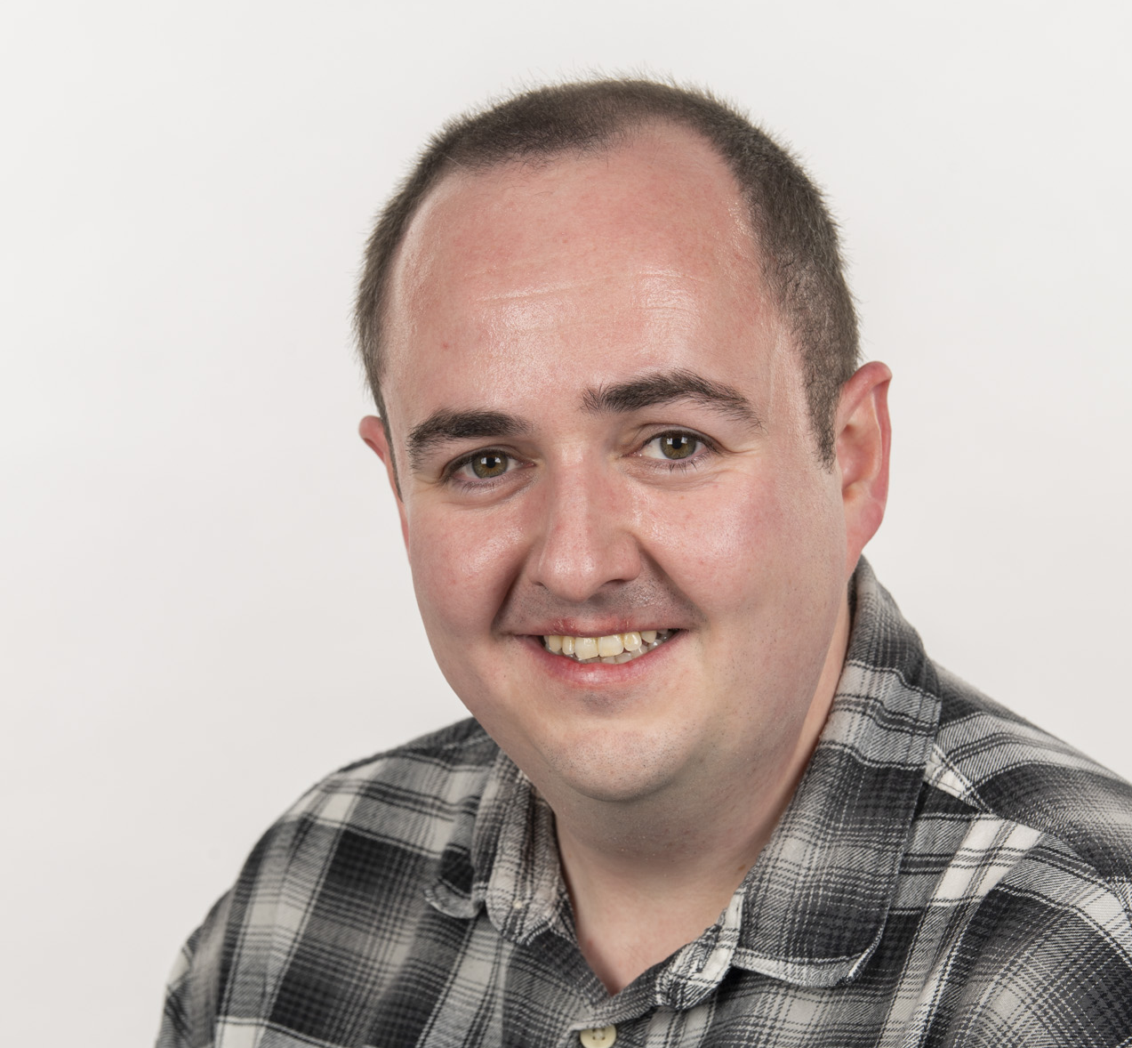
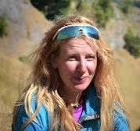
Are we GenAI experts?
Our team at the University of Glasgow are trying to help
We want to design a course which can help people self-evaluate where and how they use GenAI
Are we experts? No, with the exception of Jake!
We still think we can help anyways, our school certainty seems to think we know what we are doing (shows how much they know!)
Vinny Davies
Jake Lever
Craig Alexandar
Jenn Gaskell

Slide 21
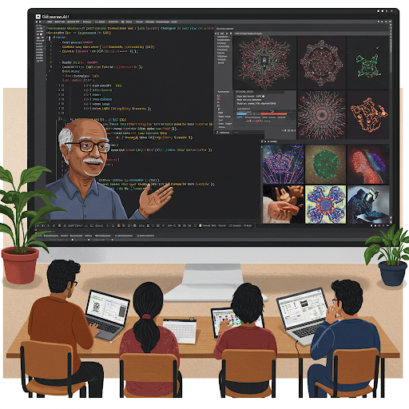
What is our course about?
It does not aim to teach the theory of Large Language Models or even neural networks
It does not aim to tell people what they should and shouldn’t do with GenAI
It does aim to encourage people to self-evaluate their own use or potential use of GenAI
It does aim to give them things to think about when using GenAI in the context of Data Science

Slide 22
Key Themes
The course structure is based around 4 key themes
Education – Understanding the strengths and weaknesses of GenAI
Development – How to use GenAI to learn and develop code/models
Reporting – Thinking about when and where it might make sense to document what has been done
Safety – Things to consider when setting guidelines
We welcome any feedback or suggestions

Slide 23
Education
Aim: To give the key concepts behind GenAI and how it works
How does it work? – How does an LLM “know” things? Where does it get the data from and how does it generate text?
What are its limitations? – Covering a range of issues such as ethics, diversity, hallucinations, bias, and higher order skills
Staying Safe with GenAI – Topics such as critical evaluation, fact checking, limitations, and information corruption in content

Slide 24
Development
Aim: Make people consider how to use GenAI in an effective manner
Learning Strategy – How do we go about learning things using GenAI? How do we map a path from what we know to what we don’t
Development Strategy – Working out what GenAI can be used for in a project. What aspects of the project might it be helpful or unhelpful with?
Effective Usage – Thinking about effective ways to communicate with GenAI tools. Avoiding effective prompting literature, just giving things to think about

Slide 25
Reporting
Aim: Make people consider how they record how they have used GenAI
Generative Process – What code was generated using GenAI? How was it tested? What systems or modelling will rely on it in the future?
Regulations & Reporting – What internal or external regulations need to be considered? Has it been discussed this with a manager or supervisor?
Ethics – Are there any ethical considerations from what you have used GenAI to do? Could someone be negatively affected by GenAI’s in build biases?

Slide 26
Safety
Aim: Help organisations thing about how they govern the use of GenAI
Education – What training do people need to use GenAI safely and effectively? What do people need to know?
Risks – What are the specific risks for the relevant tasks? How can issues be compounded by overuse of GenAI?
Processes & Documentation – What processes, document, and guidelines need to be put in place? How do you ensure these are read and adhered to?

Slide 27
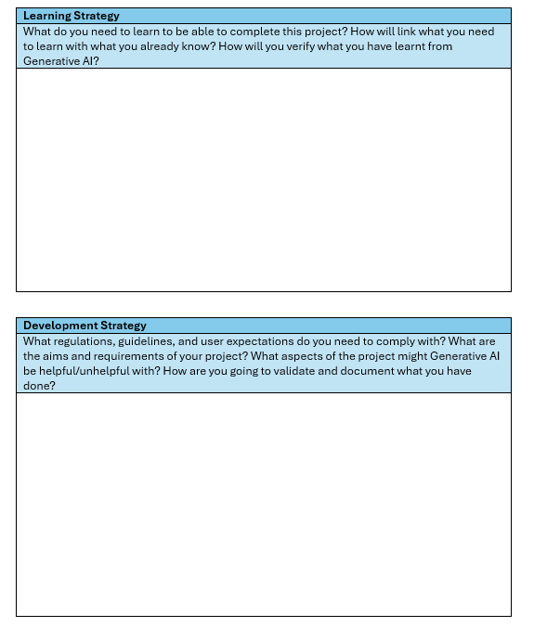
Worksheet
Creating a worksheet that can be used to encourage critical thinking and evaluations
People can take their own tasks (in person) or a generic task (MOOC) and evaluate the task against our 4 key themes
Allows us to help without giving definitive solutions
Future proofs the course

Slide 28
Using the course
We are aiming to use the course in several different ways
Students – Materials will be integrated into new courses designed to give students improved workplace skills
Staff – Training will be offered within our school and beyond. Seminars can be offered to other institutes
Industry – Workshops and seminar type sessions will be available
MOOC – We have funding to create a MOOC, making the course widely available

Slide 29

Thanks for Listening
Let us know if you have any questions or suggestions
Or feel free to reach out at:
Vinny.Davies@Glasgow.ac.uk
Slides available at:
https://github.com/vinnydavies/presentations/2025

